Slide 1

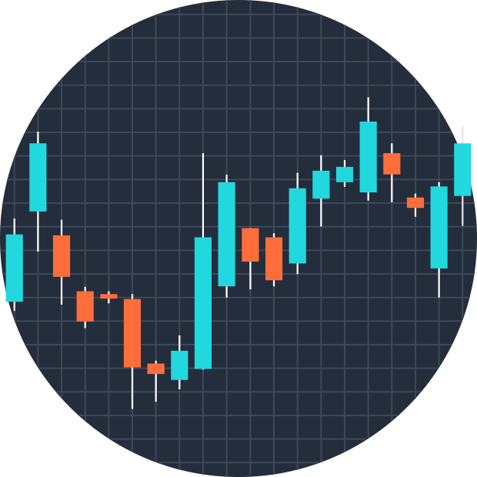
MARKET
ANALYSIS

Slide 2

MEET THE TEAM
Software and Information Systems engineering specialized in AI
Software and Information Systems engineering specialized in AI
Software and Information Systems engineering specialized in cyber security
JAN ZAATRA
RAHAF SBAIH
EILYA BALLOUT

Slide 3

Stock Value Prediction
MOTIVATION
Why AI for Stock Market Prediction?
Complexity
The stock market is influenced by a myriad of factors, including economic indicators, company performance, investor sentiment, and global events. AI's ability to process and analyze vast amounts of data makes it well-suited to unravel these intricate relationships.
01
02
Pattern Recognition
AI algorithms, particularly deep learning models like LSTM, excel at identifying patterns and trends in historical data that might not be apparent to human analysts.
Adaptability
AI models can continuously learn and adapt to new information, making them valuable tools in a constantly evolving market environment.
03

Slide 4
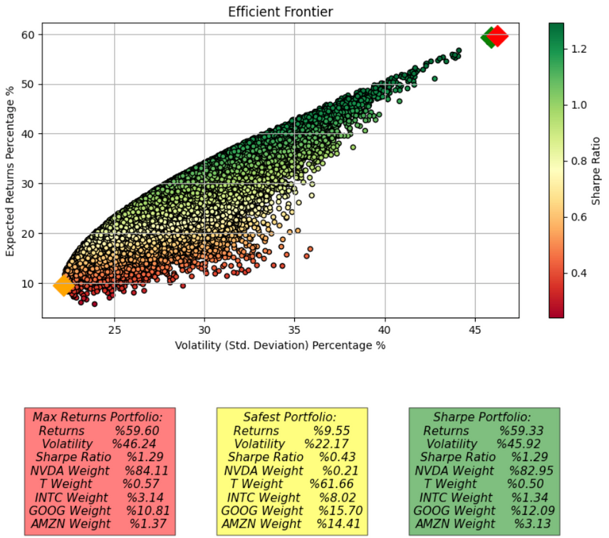
Investment Dilemma Where We Started
Given an amount of money, which stock should we invest in to get the maximum profit?
NVIDIA (NVDA), AT&T (T), Intel (INTC), Google (GOOG), Amazon (AMZN)
MAX RETURNS PORTFOLIO (RED):
Highest return, but with high volatility.
Heavily weighted towards NVDA (84.11%).
SAFEST PORTFOLIO (YELLOW):
Lowest risk, but also lower returns.
Heavily weighted towards T (61.66%).
SHARPE PORTFOLIO (GREEN):
Best risk-return balance (highest Sharpe ratio).
Diversified, but NVDA still prominent (82.95%).
INSIGHTS AND TAKEAWAYS
NVDA Dominance: Key driver of returns in top portfolios.
Risk-Return Tradeoff: Higher returns = Higher risk.
Diversification: Sharpe portfolio shows benefits of spreading risk.
Investor Choice: Portfolio selection depends on risk tolerance and goals.
FURTHER INVESTIGATION
Given NVDA's prominence in the top-performing portfolios, a deeper analysis of this stock is warranted. Understanding its drivers, risks, and potential future performance could provide valuable insights for refining investment strategies.

Slide 5
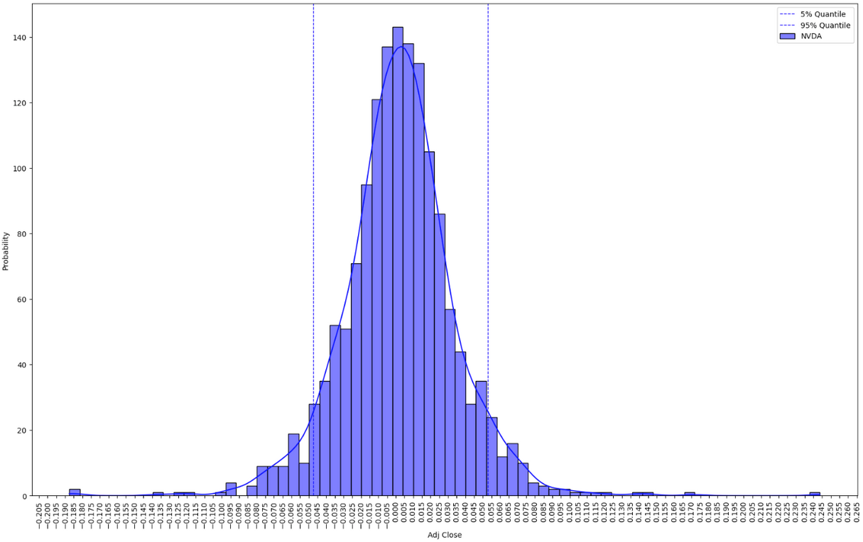
NVIDIA
Distribution Plot
SHAPE AND DISTRIBUTION
Bell-Shaped Curve: Returns follow a normal distribution.
Centered Around Zero: Indicates that most daily price changes are small, with frequent minor gains or losses.
Rightward Skew: A slight positive skew shows that large positive returns, while rare, are more likely than large losses.
Quantiles & Volatility: 90% of daily returns fall between the 5% and 95% quantiles, suggesting moderate volatility.
SUMMARY STATISTICS
Median (0.002633): Indicates a slight positive daily return.
Min (-0.187559) & Max (0.243696): Highlights the range of potential daily gains and losses.
Mean (0.002854): Positive average daily return, slightly higher than the median due to positive skew.
5% & 95% Quantiles: Typical daily returns range from -4.73% to 5.29%, reflecting moderate volatility.
INSIGHTS & TAKEAWAYS
Moderate Volatility with Upward Trend: NVDA shows a generally positive performance with moderate fluctuations.
Positive Returns: Both median and mean returns suggest potential for gains, averaging around 0.29% daily.
Risk of Losses: Investors should note the potential for significant daily losses (up to 18.76%).
Typical Movements: Most daily returns fall within -4.73% to 5.29%, offering a sense of expected price changes.

Slide 6
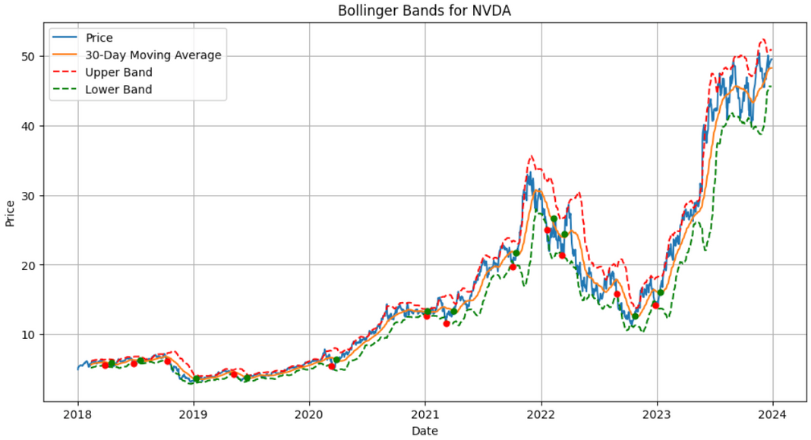
NVIDIA
Bollinger Bands Plot
UNDERSTANDING THE BOLLINGER BANDS PLOT
Price (Blue Line): Represents NVDA's actual adjusted closing price over time.
30-Day Moving Average (Orange Line): Smooths out fluctuations to highlight the overall trend.
Upper & Lower Bands (Red & Green Dashed Lines): Dynamic range based on the moving average and volatility, indicating high or low volatility periods.
Buy Signals (Red Dots): Appear when the price dips below the lower band, suggesting potential buy opportunities.
Sell Signals (Green Dots): Indicate possible sell points when the price rises above the moving average after a buy signal.
KEY OBSERVATIONS
Volatility Trends: The varying distance between bands reflects changing volatility—wider bands indicate higher volatility, narrower bands imply lower volatility.
Price Action: The price typically remains within the bands, but breakouts can signal potential trend shifts.
Trading Signals: Red and green dots mark potential buy and sell opportunities based on the Bollinger Bands strategy.
Profitability: A profit of $67.32 (3.98%) suggests that this strategy yielded a positive return during the analyzed period.
INTERPRETATION & INSIGHTS
Volatility: NVDA experienced periods of both high and low volatility, as indicated by the bands' width.
Strategy Effectiveness: The Bollinger Bands strategy generated a modest profit, though past performance is no guarantee of future results.
Trading Approach: This plot offers a visual guide for identifying potential entry (buy) and exit (sell) points based on volatility. Traders might consider buying near the lower band and selling near the upper band or when the price crosses above the moving average.

Slide 7
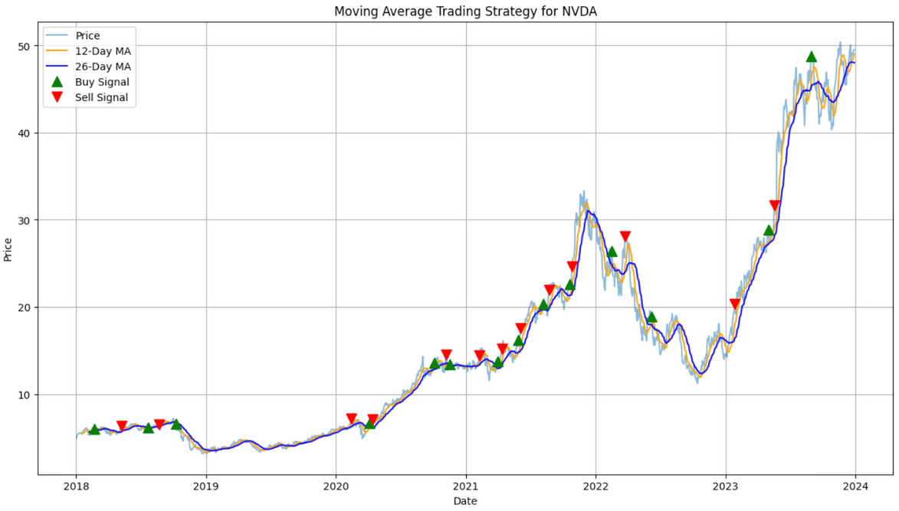
NVIDIA
Moving Average Plot
UNDERSTANDING THE MOVING AVERAGE CROSSOVER PLOT
Price (Grey Line): Reflects NVDA's actual adjusted closing price over time.
12-Day Moving Average (Orange Line): Short-term, more responsive to recent price changes.
26-Day Moving Average (Blue Line): Long-term, smoother, representing broader trends.
Buy Signals (Green Triangles): Triggered when the 12-day MA crosses above the 26-day MA, suggesting a potential buying opportunity.
Sell Signals (Red Triangles): Generated when the 12-day MA crosses below the 26-day MA, indicating a potential selling opportunity.
KEY OBSERVATIONS
Trend Following: The strategy buys during uptrends (12-day MA above 26-day MA) and sells during downtrends.
Multiple Trades: Numerous buy and sell signals indicate active trading throughout the period.
Profitability: The strategy yielded a total profit of 99.31% in long positions, reflecting NVDA's strong uptrend.
INTERPRETATION & INSIGHTS
NVDA's Strong Uptrend: The high profit indicates NVDA's robust upward movement during the analyzed period.
Moving Average Effectiveness: The crossover strategy was effective in identifying profitable trades for NVDA.
Potential Drawdowns: While overall profit is significant, periods of drawdowns (losses) between signals are possible, even if not explicitly shown.

Slide 8
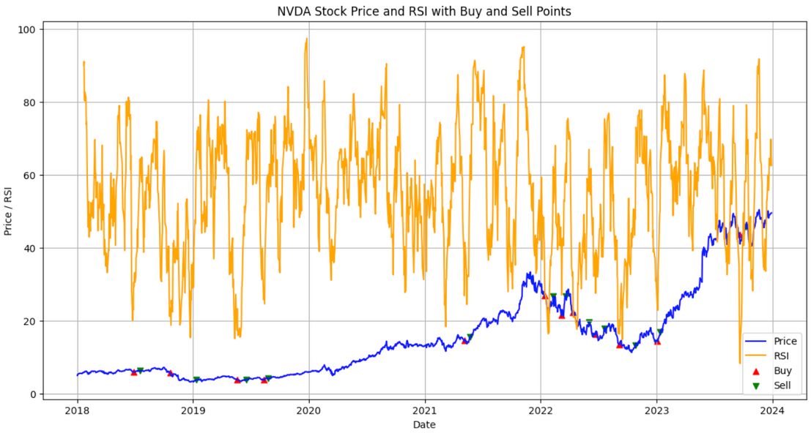
NVIDIA
RSI Plot
UNDERSTANDING THE RSI-BASED TRADING PLOT
Price (Blue Line): Reflects NVDA's actual adjusted closing price over time.
RSI (Orange Line): Relative Strength Index, a momentum oscillator ranging from 0 to 100, indicating overbought or oversold conditions.
Buy Signals (Red Triangles): Triggered when RSI falls below 30 (oversold) and current volume is lower than the 14-day average, suggesting a potential buying opportunity.
Sell Signals (Green Triangles): Generated when RSI rises above 60 (overbought), indicating a potential selling opportunity.
KEY OBSERVATIONS
RSI Oscillations: The RSI fluctuates, reflecting changing momentum in NVDA's price.
Trading Signals: Red and green triangles mark potential buy and sell opportunities based on the RSI.
Profitability: The strategy yielded a profit of $82.38 and a return of 167.08%, indicating strong performance.
INTERPRETATION & INSIGHTS
RSI as a Leading Indicator: The RSI often signals price movements before they occur—rising after oversold conditions and falling after overbought levels.
Strategy Effectiveness: This RSI-based strategy was highly successful for NVDA, generating significant gains.
Timing is Key: The strategy's success depends on accurately timing entries and exits; mistimed trades could result in missed opportunities or losses.

Slide 9

MODELS
NVIDIA
LOGISTIC REGRESSION
ARIMA
LSTM
Utilized to predict NVDA's stock price movements by merging economic indicators such as the Tech Index, Finance Index, Europe Stock Index, and Russell 2000 Index, alongside technical indicators like GAP and VolumeChange.
Used for short-term forecasting of NVDA's stock price, relies solely on past values of the stock's adjusted closing price, doesn't incorporate external factors like ETFs, yet demonstrates strong predictive ability with low error metrics with actual price movements.
Trained without ETFs due to improved performance.
LSTM's strength lies in capturing long-term dependencies and complex, non-linear relationships in the stock's price data.

Slide 10



LOGISTIC REGRESSION
INCORPORATING ECONOMIC INDICATORS AND DATA PREPARATION IN LOGISTIC REGRESSION
DATA CLEANING & FEATURE SELECTION
LOGISTIC REGRESSION & ECONOMIC INDICATORS
In this analysis, we enhanced the predictive model by incorporating various economic indicators through ETFs:
Tech Index (NASDAQ Composite): Tracks the technology sector, crucial for understanding market sentiment, especially for tech-heavy stocks like NVDA.
Finance Index (XLF ETF): Reflects the health of the financial sector, influencing market stability and investor confidence.
Europe Stock Index (VGK ETF): Captures European equities' performance, offering insights into global economic trends and their impact on U.S. markets.
Russell 2000 Index: Represents small-cap U.S. companies, providing a broader market perspective beyond large-cap stocks.
IMPORTANCE OF THESE ETFS
Enhanced Predictive Power: Incorporating macroeconomic factors offers a deeper understanding of what drives NVDA's price movements, improving model accuracy.
Risk Assessment: Analyzing NVDA's relationship with these indicators helps evaluate its sensitivity to different market conditions.
Contextual Understanding: Connecting NVDA's performance to broader market trends allows for more informed investment decisions.
ADDITIONAL FEATURES
GAP: Measures the percentage difference between closing and opening prices, capturing intra-day price movements and market sentiment.
VolumeChange: Tracks the percentage change in trading volume from the previous day, indicating shifts in investor interest and activity.
OUTLIER REMOVAL (Z-SCORES)
Eliminates extreme values to ensure the model focuses on typical patterns rather than skewed by anomalies.
MULTICOLLINEARITY CHECK (VIF)
Removes features with high VIF to prevent redundancy and ensure each feature adds unique value to the model.

Slide 11
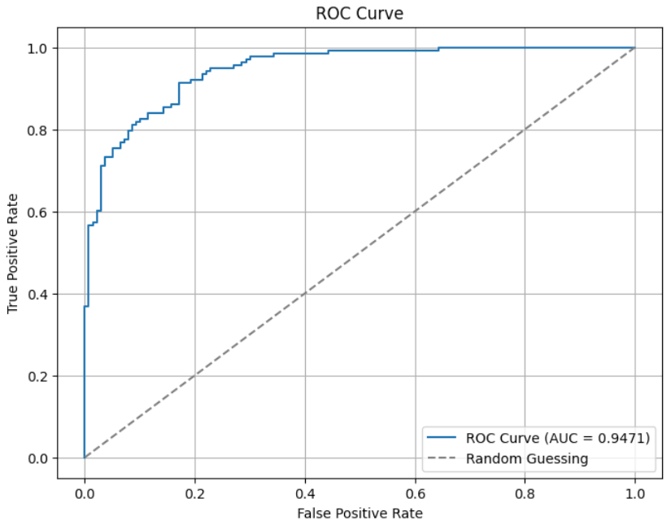
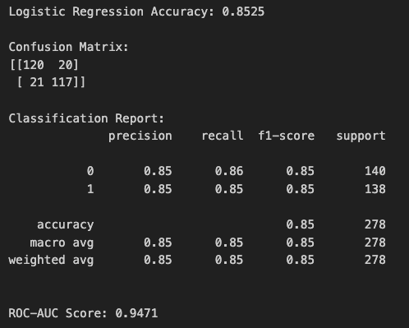
LOGISTIC REGRESSION
PERFORMANCE METRICS OF LOGISTIC REGRESSION MODEL
RESULTS EXPLANATION
Logistic Regression Accuracy (85.25%):The model correctly predicted NVDA's price movements 85.25% of the time, indicating strong predictive capability.
CONFUSION MATRIX BREAKDOWN:
True Positives (117): Correctly predicted price increase.
True Negatives (120): Correctly predicted price decrease.
False Positives (20): Incorrectly predicted price increase.
False Negatives (21): Incorrectly predicted price decrease.
ROC-AUC Score (0.9471): Shows excellent ability to distinguish between price increases and decreases.
ROC Curve: Reinforces high ROC-AUC score, demonstrating a high true positive rate with a low false positive rate across classification thresholds.
SUMMARY
The logistic regression model, incorporating technical and macroeconomic factors, effectively predicts NVDA's price movements with high accuracy and strong discriminatory power.

Slide 12
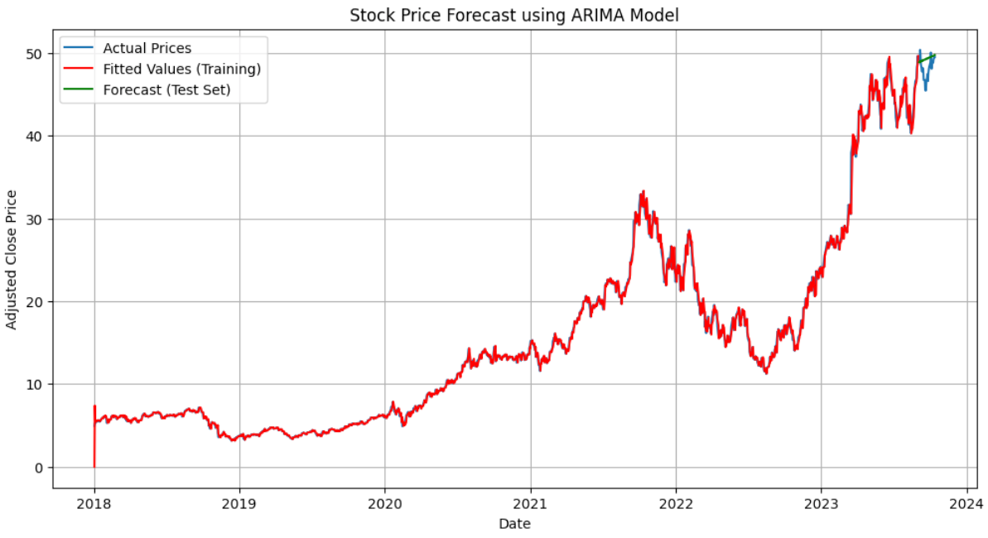
ARIMA
Limitations and Effectiveness of ARIMA for Short-Term Forecasting
Limitations and Performance of ARIMA Model
Why ETFs Couldn't Be Included:
ARIMA models are univariate and rely solely on past values of the target variable (stock price), excluding external factors like ETFs.
ARIMA: A Short-Term Model:
Suitability: Best for short-term forecasting, capturing immediate trends and patterns.
Accuracy: Generally decreases with longer forecast horizons.
Advantages of ARIMA:
Simplicity: Easy to understand and implement.
Effectiveness: Accurate for short-term forecasts with clear patterns.
Flexibility: Customizable with parameters (p, d, q).
Performance Visualization:
Green Line: Represents ARIMA’s forecasted values, showing smooth alignment with actual prices (blue line).
Low Metrics: MSE (2.8517) and MAE (1.3373) indicate accurate predictions.
Additional Insights:
Model Parameters: p=3, d=2, q=3, chosen for optimal performance.
Training vs Test Set: Good fit on training data, effective short-term forecasting on test data.
Summary
The ARIMA model provides effective short-term predictions for NVDA's stock price, capturing trends with high accuracy and smooth forecasts, but does not accommodate external indicators like ETFs.

Slide 13



LSTM
LSTM MODEL
ADDITIONAL POINTS
Why ETFs Weren't Included in LSTM Analysis
Exclusion Rationale
Performance: LSTM model performed better (lower MSE and MAE) without ETFs, indicating that including them might have introduced noise or irrelevant information.
Complex Relationships: ETFs' complex and non-linear relationships with NVDA’s stock price may have made it difficult for the LSTM to capture those dependencies effectively.
LSTM vs. ARIMA
Long-Term Memory: LSTMs retain information over longer periods, unlike ARIMA which focuses on recent past values.
Handling Non-Linearity: LSTMs model complex, non-linear relationships effectively, crucial for capturing stock price dynamics.
Benefits of LSTM
Adaptability: Versatile across different time series patterns.
Feature Learning: Automatically learns relevant features from raw data.
Predictive Power: Better for long-term forecasts and capturing non-linear relationships.
DATA SCALING
Scaling the data between 0 and 1 is important for LSTMs as it helps stabilize the training process and prevents large input values from dominating the learning.
MODEL ARCHITECTURE
The two LSTM layers with dropout help the model learn complex patterns while mitigating overfitting.
TRAINING AND TEST SPLIT
The use of a test set allows for an unbiased evaluation of the model's predictive performance on unseen data.

Slide 14
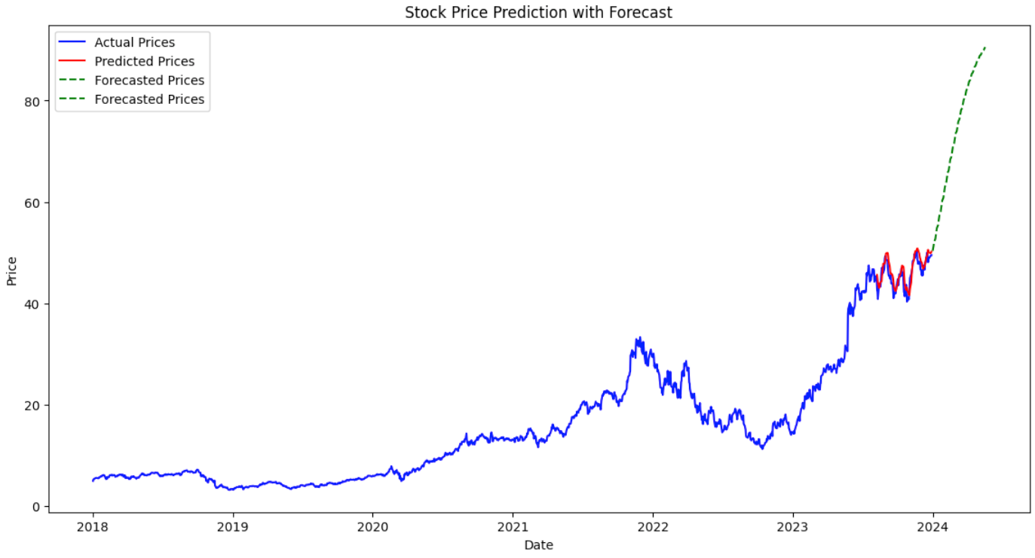
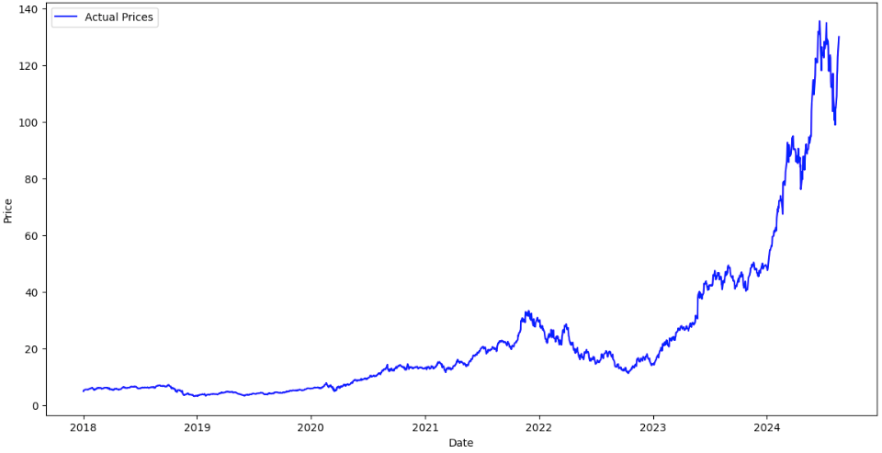
LSTM
PERFORMANCE METRICS
OF LSTM
RESULTS ANALYSIS
Low MSE and MAE: The low Mean Squared Error (2.3763) and Mean Absolute Error (1.2024) indicate that the LSTM model's predictions are quite close to the actual prices in the test set. This suggests a good fit and strong predictive capability.
Visual Confirmation: The plot visually reinforces the model's accuracy. The red line (predicted prices) closely follows the blue line (actual prices) in the test set, demonstrating the model's ability to capture the recent price movements.
Promising Forecast: The green dashed line (forecasted prices) extends beyond the actual data, showing the model's prediction for the next 100 days. While the second image (Lower Image) confirms that the forecast aligned well with the actual subsequent price increase, which is a very positive sign.

Slide 15
Summary of Results
Logistic Regression
Accuracy: 85.25%
ROC-AUC Score: 0.9471
Benefits: Incorporating ETFs improved predictive power and risk assessment, with good overall performance in classifying price movements.
ARIMA
Accuracy: Good short-term forecast with low MSE (2.8517) and MAE (1.3373).
Characteristics: Effective for short-term forecasting, but limited by its inability to include external factors like ETFs.
Benefits: Simplicity and effectiveness in capturing short-term trends, though its accuracy can degrade over longer periods.
LSTM
Accuracy: High with low MSE (2.3763) and MAE (1.2024).
Characteristics: Excellent for capturing long-term dependencies and handling non-linearity.
Results: The LSTM model closely matched actual prices and provided a promising forecast, outperforming the other models.
Recommendation
Based on the results, the LSTM model is the most effective for predicting NVDA's stock price due to its superior handling of long-term dependencies and non-linear relationships. It demonstrated the best accuracy and forecast performance among the models tested. For robust stock price forecasting, leveraging the LSTM model and continuously updating it with new data and market conditions is recommended.

Slide 16

THANK YOU

